Slide 1


Detecting Fake News on Social Media:
A Machine Learning Approach

Slide 2

Disclaimer on Political Dataset
Nature of the Data: This project uses a dataset of political statements, which may reference sensitive topics, political figures, and contentious policy issues.
No Endorsement: The inclusion of any specific individual, party, or subject matter does not imply endorsement or opposition.
Bias Awareness: The dataset could reflect biases present in the original sources. Some views or claims may be misrepresented or incomplete.
Research Purpose: All analyses are conducted solely for the academic purpose of exploring fake news detection methods and do not represent any political stance.

Slide 3
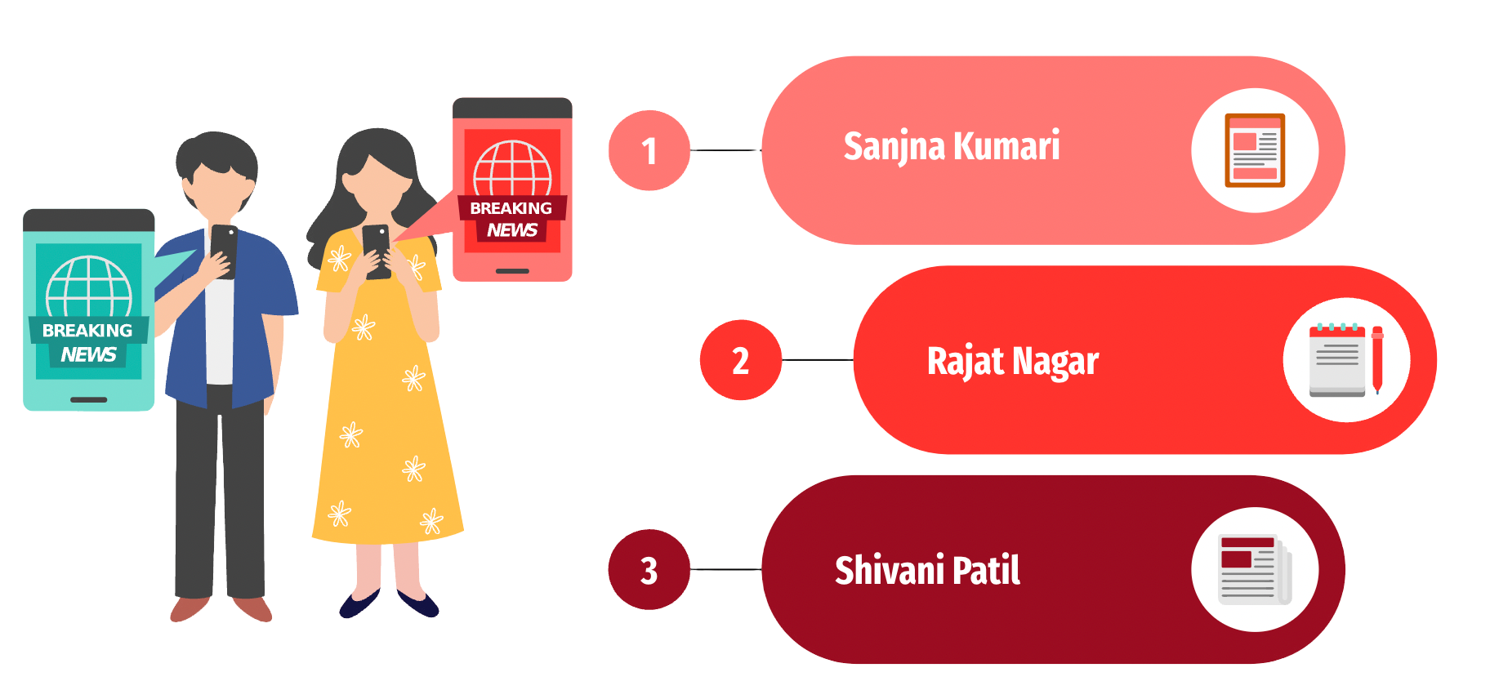
Inside Socials Team

Slide 4


Problem Overview
Fake news is a growing societal concern, significantly affecting public opinion, election outcomes, and financial markets.
Social media has become the dominant source of news for millions, enabling instant information sharing.
Societal Consequences:
Influenced voter behavior during the 2016 U.S. election.
Fake news about Barack Obama caused a $130 billion stock market drop.
A 2018 study by MIT found that fake news spreads six times faster than true news.

Slide 5


Project Aim and Objective
Aim:
Develop machine learning models to detect and classify news statements as real or fake.
Objective:
Assist in minimizing the spread of misinformation by creating automated systems prioritizing high recall for accurate detection.
Machine learning can analyze large datasets efficiently, uncover patterns, and adapt to new forms of misinformation.

Slide 6
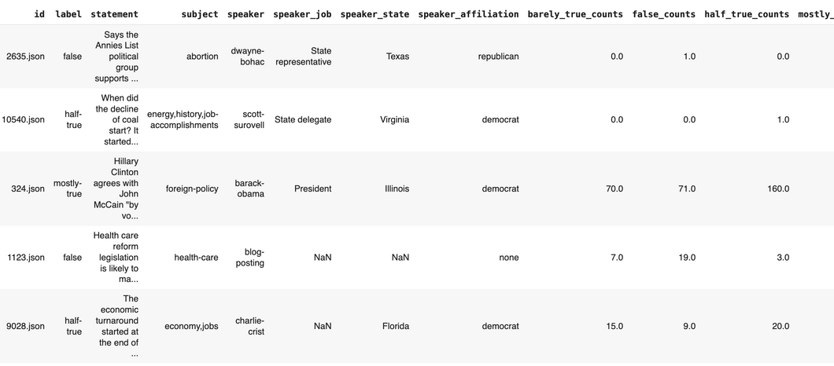

Dataset Overview
Dataset Source:
PolitiFact: Liar, Liar Pants on Fire: A New Benchmark Dataset for Fake News Detection.
PolitiFact: Known for verifying the truthfulness of public statements.
Dataset Size: 12,791 labeled statements.
Key Attributes:
ID: Unique identifier for each statement.
Label: Original multi-class labels (e.g., true, mostly-true, half-true, false, barely-true,
pants-fire).
Statement: The news statement to classify.
Speaker Details: Includes speaker's role, job, state, and political affiliation.
The LIAR dataset is widely used for its variety of political claims and metadata, making it ideal
for fake news research.

Slide 7

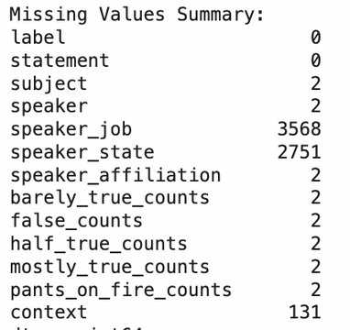
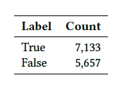
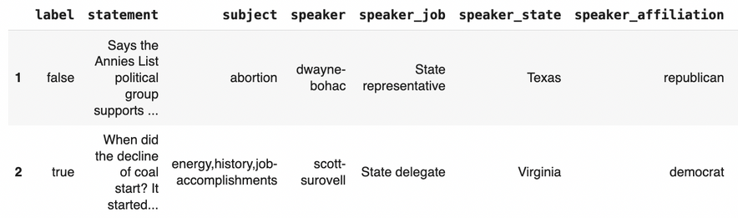
Data Cleaning & Transformation
Removed the ‘id’ column as it was not useful for analysis.
Removed duplicates to avoid bias.
Handled missing data by:
Replacing empty strings with NaN.
Replaced missing values in string columns with 'Unknown'.
Replaced missing values in numerical columns with 0.
Simplified the classification task by mapping multiple labels into two categories using binary classification transformation:
Mapped the original labels into ’true’ if they were ’true’,’mostly-true’, or ’half-true’.
Otherwise, mapped to ’false’.
The dataset now has 7,133 ’true’ statements and 5,657 ’false’ statements.

Slide 8
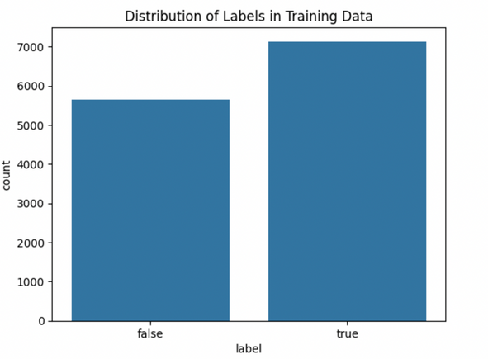
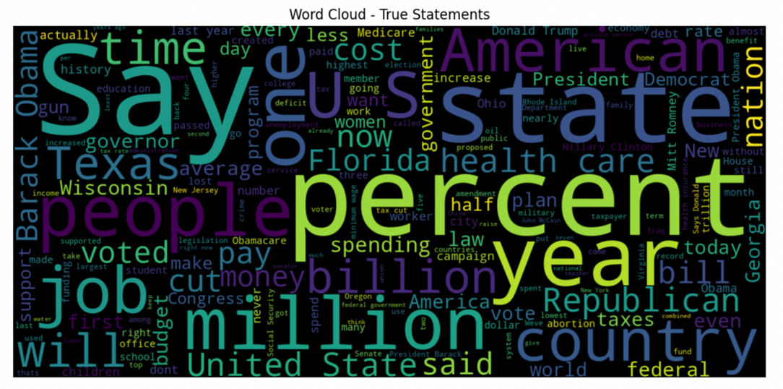
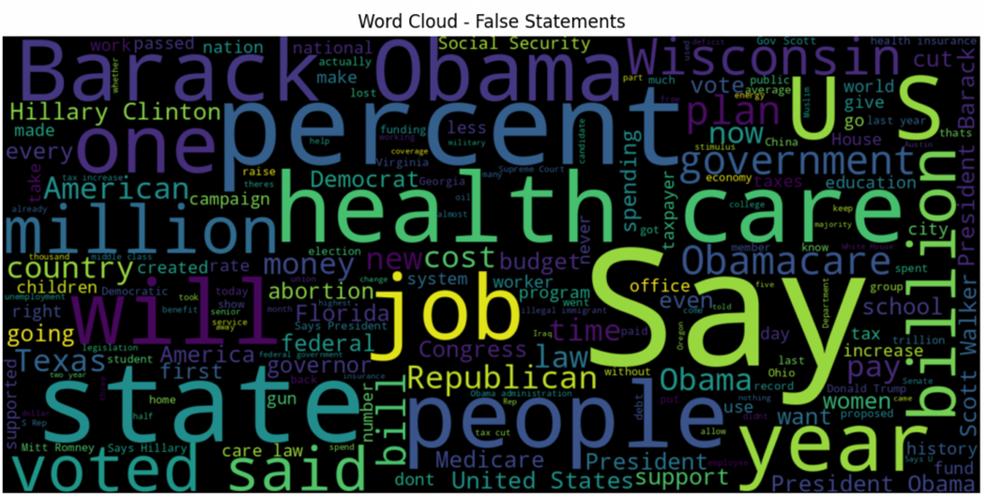
Exploratory Data Analysis
True statements often contain neutral and factual language.
False statements frequently use emotional or exaggerated language.

Slide 9
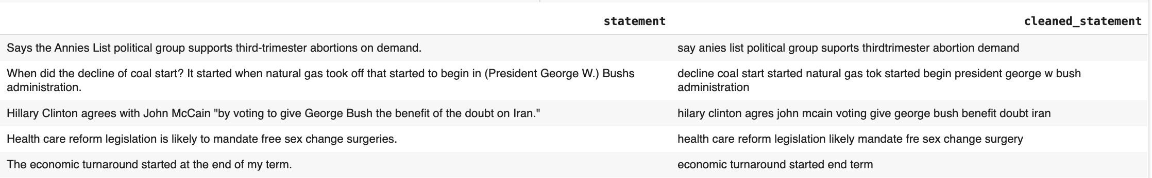
Data Preprocessing
Lowercasing & Removing URLs:
Converted all text to lowercase to ensure uniformity and eliminated web addresses.
Removing Emails,Numbers, Punctuation:
Removed email addresses , stripped out numerical data , and cleared punctuation marks.
Removing Repeating Characters & Extra Whitespaces:
Reduced repeated characters to a single instance and cleaned up unnecessary spaces.
Tokenization & Removing Stopwords
Splitted text into individual words (tokens) and removed common words that do not carry significant meaning.
Lemmatization:
Reduced words to their base form to treat different forms of a word as the same token.

Slide 10
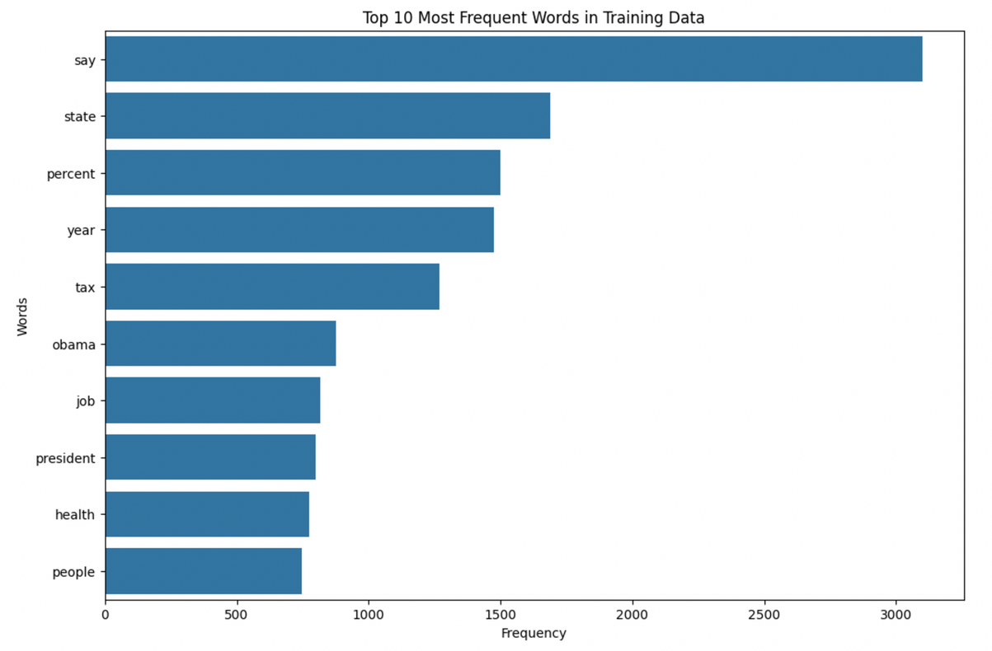
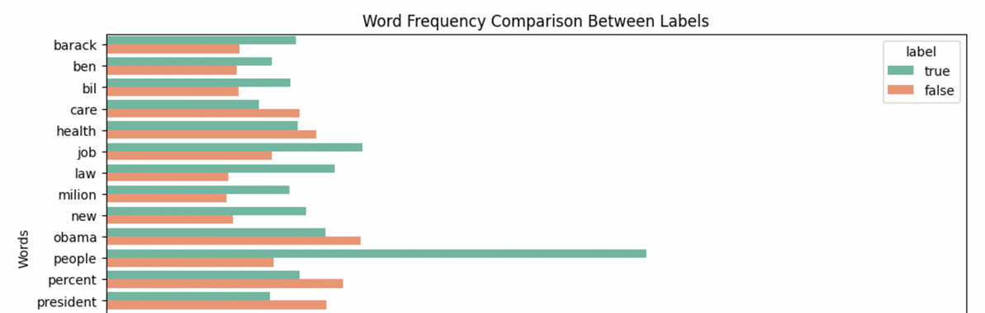
Word Frequency Analysis
01
Compiled all words from the cleaned_statement column.
02
Calculated the frequency of each word.
03
Top 10 most frequent words in
statements.

Slide 11

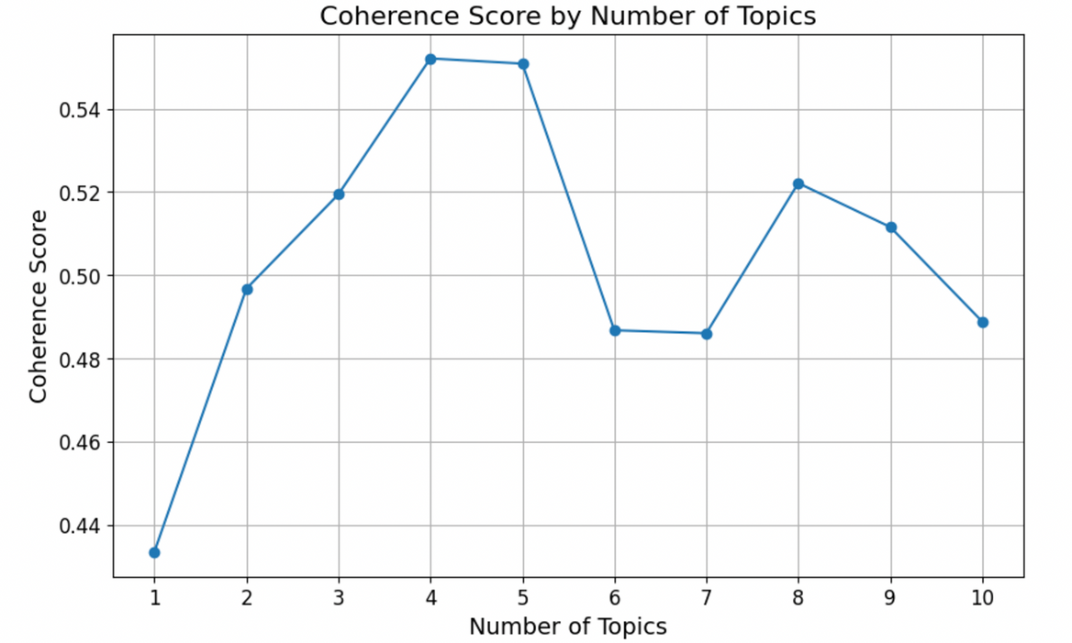
Topic Modeling with LDA
TOKENIZED CLEANED TEXT.
VECTORIZED DATA USING COUNTVECTORIZER.
RAN LDA FOR 1-10 TOPICS.
The coherence score peaked at 4 topics, indicating the best number for this dataset..

Slide 12
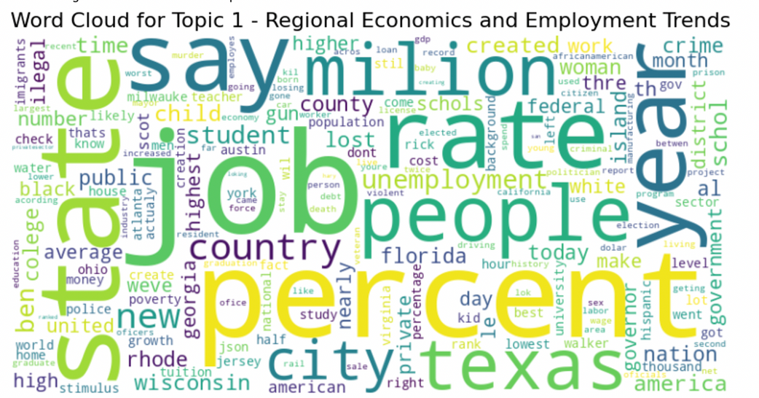
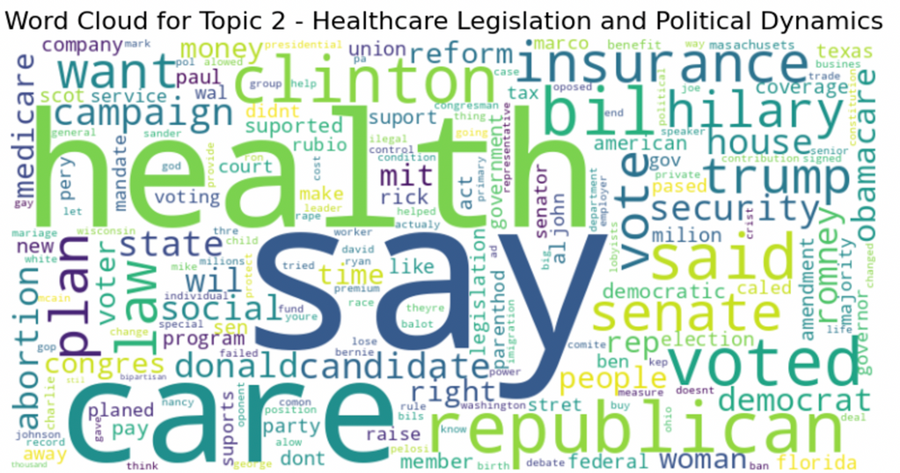
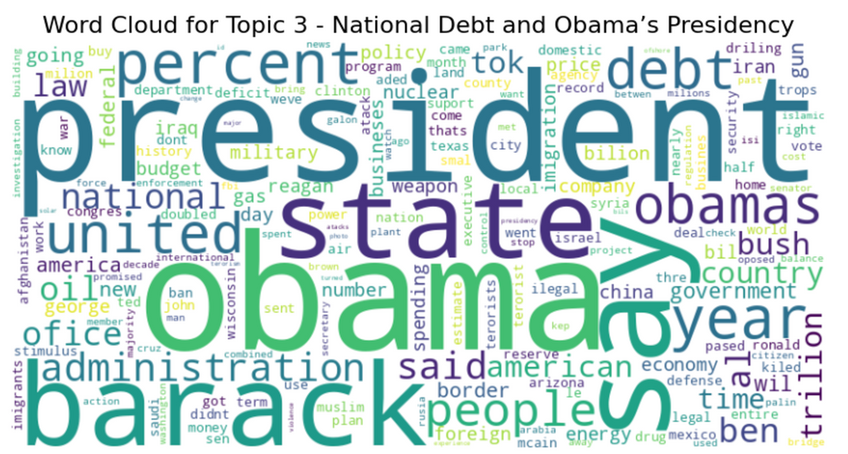
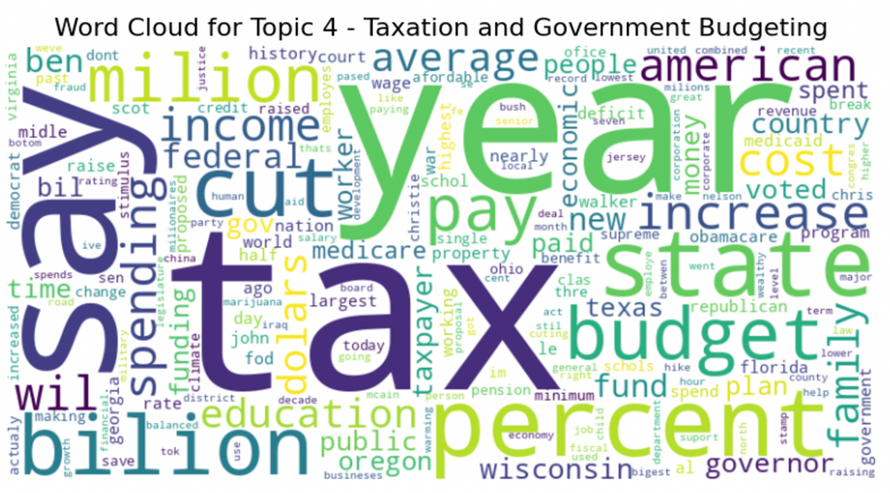
Topics & Word Clouds
After training Final LDA Model.

Slide 13
From Preprocessing & LDA to Feature Engineering
Recap: Data has been cleaned and tokenized; LDA used to find underlying topics.
Focus Now: Converting text and extra info (metadata) into numerical features.
Goal: Identify which inputs help best in detecting fake news.

Slide 14
Metadata Features and Their Role
Metadata Analyzed: Subject, Speaker, Speaker Job, Speaker State, Speaker Affiliation
Why Consider Metadata? Might help detect patterns (e.g., certain speakers or topics linked to misinformation).
Challenge: Metadata is categorical, needs encoding to be understood numerically.

Slide 15
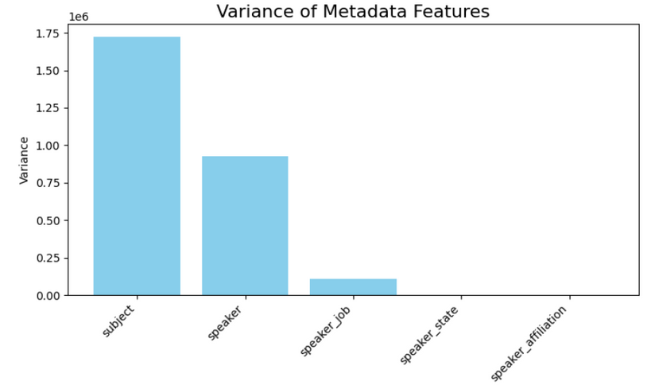
Variance Analysis of Metadata
Process: Applied Label Encoding to convert categories into numbers.
Result: High variance in 'Subject' and 'Speaker' → These features show a wide range of values.
Lower variance in 'Speaker Affiliation' → Fewer distinct political affiliations in the dataset.

Slide 16
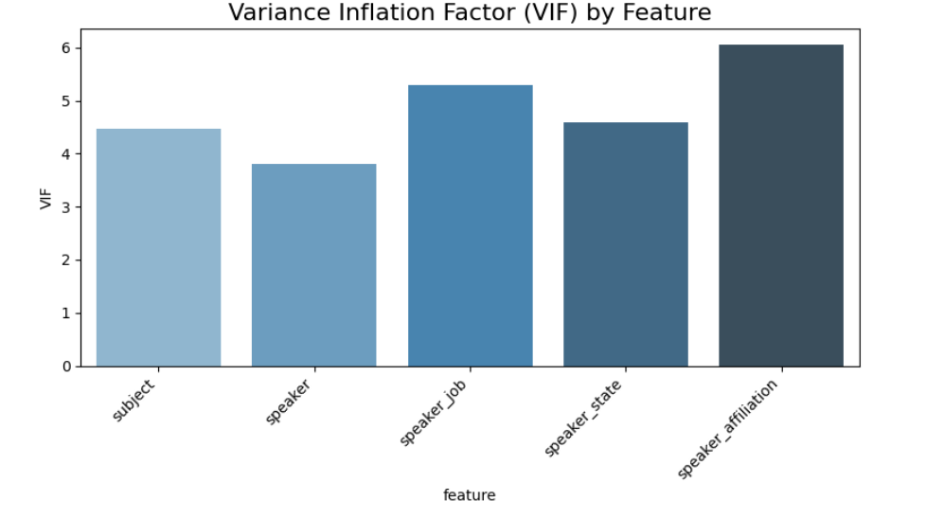
Checking for Overlapping Information (Multicollinearity)
Method: Variance Inflation Factor (VIF) used to detect when features overlap in meaning.
Finding: All metadata features had high VIF scores (>3).
Implication: Features were providing repetitive or redundant signals, potentially confusing the model.

Slide 17
Decision on Metadata Features
Key Insight: Chi-Square test on textual data didn’t rank metadata features as important.
Conclusion: Due to high VIF and low contribution, metadata features were excluded.
Benefit: A leaner set of input variables helps the model focus on what matters.

Slide 18
Textual Feature Representations
Bag of Words (BoW): Counts each word’s frequency. Simple, but no sense of importance.
TF-IDF: Weighs words by how unique or informative they are across the entire corpus.
GloVe Embeddings: Pre-trained word vectors capture semantic meaning and relationships between words.

Slide 19
Why Multiple Representations?
BoW & TF-IDF: Good for initial filtering of key terms.
GloVe: Adds context by understanding word similarity and relationships.
Combination: Helps us pick the best approach for our final classifier.

Slide 20
Feature Selection with Chi-Square
Applied Chi-Square test to BoW and TF-IDF features to select top 100.
Selected features likely include politically relevant words and important policy terms.
GloVe was not filtered with Chi-Square due to its continuous nature; it remains at 100 dimensions.

Slide 21
Final Feature Dimensions
BoW reduced to 100 features via Chi-Square.
TF-IDF reduced to 100 features via Chi-Square.
GloVe embeddings already provide 100-dimensional vectors.
End result: Each representation now has 100 features.

Slide 22
Final Feature Set
Dropped high-VIF metadata features.
Retained top textual features (100 from BoW, 100 from TF-IDF) and included GloVe (100 dimensions)
Result: A cleaner, more focused set of inputs that emphasize meaningful words and their semantic relationships.

Slide 23


Models Overview
Focused on three models: Naive Bayes, SVM, Random Forest.
Evaluated across three feature representations: BoW, TF-IDF, and GloVe.
Prioritized recall to minimize false negatives.

Slide 24
NAIVE BAYES CLASSIFIER
Feature Type | Cross-Validation Recall | Test Recall
BoW | 74.69% | 73.23%
TF-IDF | 93.45% | 92.36%
GloVe | 61.85% | 62.09%

Slide 25
SUPPORT VECTOR MACHINE
Feature Type | Cross-Validation Recall | Test Recall
BoW | 82.68% | 83.11%
TF-IDF | 84.21% | 84.23%
GloVe | 79.27% | 78.56%

Slide 26
RANDOM FOREST CLASSIFIER
Feature Type | Cross-Validation Recall | Test Recall
BoW | 77.41% | 77.51%
TF-IDF | 71.70% | 70.71%
GloVe | 72.64% | 72.60%

Slide 27
PERFORMANCE
COMPARISON
Model | Feature Type | CV Recall | Test Recall | CV F1 | Test F1
Naive Bayes | TF-IDF | 93.45% | 92.36% | 72.40% | 71.79%
SVM | TF-IDF | 84.21% | 84.23% | 70.91% | 71.08%
Random Forest | BoW | 77.41% | 77.51% | 67.40% | 67.19%

Slide 28
Results Summary
Naive Bayes with TF-IDF achieved the highest recall (92.36%).
SVM with TF-IDF balanced precision and recall (84.23% recall).
Random Forest showed moderate recall (77.51%) but lagged behind others.
Insight: TF-IDF consistently outperformed BoW and GloVe across models.

Slide 29

Any Questions?

